Slide 1

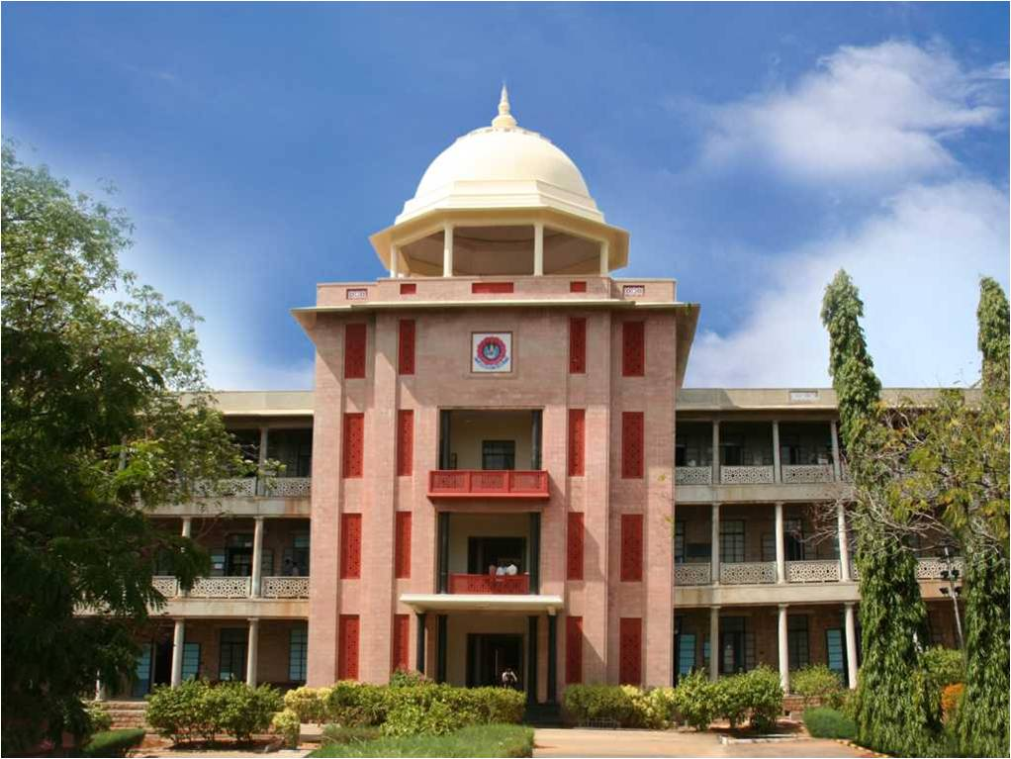
IOT BASED PRODUCT RECOMMENDATION SYSTEM USING MACHINE LEARNING
THIAGARAJAR COLLEGE OF ENGINEERING, MADURAI-15
(A Govt. Aided Autonomous Institution affiliated to Anna University)
- where quality and ethics matter
GUIDE :
Dr C Sridharan
TEAM MEMBERS :
Naveen Karthik K 19C059
Nitin Vinayak S 19C062
Rajarajesvarri G 19C077
10/02/2023
<Department Name>

Slide 2
Introduction
In today's world, one of the major problems faced by Shop-Owners is the lack of data and insights on customer preferences and behavior.
This makes it difficult for the shopkeepers to make decisions regarding the restocking of items in their shop.
Here comes the Inventory Management System into play, where we use a smart trolley to detect items that the customers put in their trolley during shopping. It uses RFID and collects required data while it also carries out automated billing.
We then feed the data collected from the customer's shopping behaviors to a Machine Learning model and give a personalized recommendation to the shopkeeper about the items that they might want to restock.
10/02/2023
Department of Computer Science and Engineering

Slide 3
Literature Review
Automated Shopping Cart Using RFID with a Collaborative Clustering Driven Recommendation System
review here
10/02/2023
Department of Computer Science and Engineering

Slide 4
Literature Review
Smart Trolley for Smart Shopping with an Advance
According to this paper, in the current scenario, people are more attracted to buy groceries from Supermarket/Hypermarket. In such a case, finding the essential need of any customer in supermarket consumes more time and after all findings the customer need to wait in the billing queue to complete billing process of the selected product. Currently, due to the Covid-19 pandemic, the customers are strictly instructed to maintain social distance but practically it is not possible especially in the billing process. To overcome this significant challenge, this research work proposes a smart trolley based on Internet of Things [IoT] with an advanced billing system that makes shopping easier and secured and also avoids standing in long queue. The proposed system consists of a smart trolley attached with LCD display, barcode scanner and a Raspberry-pi. This exploratory model is intended to completely eradicate the tedious shopping interaction and administration-related issues. The proposed framework can be undoubtedly implemented at a business scale under the genuine situation.
10/02/2023
Department of Computer Science and Engineering

Slide 5
Literature Review
Product Recommendation System for Supermarket
review here
10/02/2023
Department of Computer Science and Engineering

Slide 6
Problem Formulation
The problem faced by the offline store owners is the lack of data and insights on customer preferences and behavior. This can make it difficult for them to make informed decisions on inventory, promotions, and marketing strategies and to recommend products based on the availability of the current stocks and arrival of new stocks.
An IoT-based recommendation system using machine learning could help store owners collect and analyze data on customer interactions and preferences, and provide personalized recommendations for products and promotions to the store owners and make the most sold and it’s related products always available. This would help store owners increase sales and improve customer satisfaction.
10/02/2023
Department of Computer Science and Engineering

Slide 7
Objectives
To automate the billing process instead of waiting for long queues at stores.
To recommend a particular product and all of it’s related products based on the availability of current stocks and arrival of new stocks.
To manage the stocks better by collecting the necessary information such as the goods sold, available goods and to recommend the frequently sold products and their related products.
To implement better marketing strategies, to increase the sales of goods and services and make the business profitable.
10/02/2023
Department of Computer Science and Engineering

Slide 8
Methodologies to meet the Objectives
To automate the billing process, we use a RFID scanner and read the objects that the customer places in their trolley during shopping.
We have chosen the RFID scanner because it the one of the most recent technologies that has proven to be very efficient. RFID is the optimal scanner that we can use to automate the billing process in shops.
We use a Arduino to build the RFID scanner system. And we use Wokwi as the simulation tool in case of IoT.
In Inventory Management aspect, we use machine learning to build a recommendation system to recommend the shopkeepers with the products that they might want to restock.
10/02/2023
Department of Computer Science and Engineering

Slide 9
Work Completed
10/02/2023
Department of Computer Science and Engineering

Slide 10
Expected Outcomes
For the Smart trolley to read the RFID cards in the items and automatically add it to the customer's bill. At the end all the customer has to do is pay and take delivery of the items.
The shopkeepers will be provided with a clear recommendation of the products they need restock.
The shop-owners can manage the stocks better by collecting the necessary information such as the goods sold, available goods and to recommend the frequently sold products and their related products.
10/02/2023
Department of Computer Science and Engineering

Slide 11
Action Plan
Construct an IoT-based Scanner system that uses RFID scanner to scan the items.
Fit the Scanner system into a shopping trolley in-order to achieve automated billing.
Build a Recommendation system using machine learning.
Code to feed the data collected using the scanner into the Recommendation system.
Code to display the recommended products outputted by the model.
10/02/2023
Department of Computer Science and Engineering

Slide 12
References
10/02/2023
Department of Computer Science and Engineering

